Slide 1

CANTEEN MANAGEMENT
SYSTEM
BY SNEHA S, SRINIDHI A

Slide 2
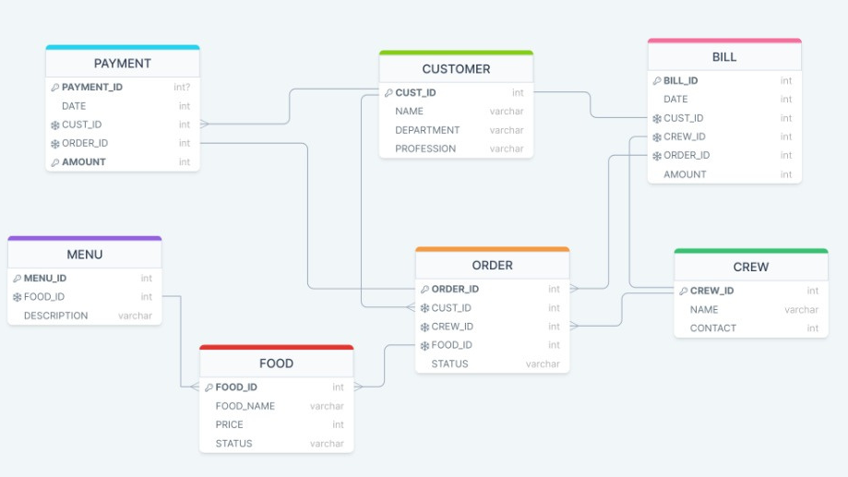
INTRODUCTION
Canteen Management System is a project which is based on a Canteen that is operating on a College Campus. The database contains seven tables namely: Crew, Customer, Food, Menu, Orders, Payment and Bill.

Slide 3
DATABASE DESIGN
01
05
Customer Table
Orders Table
02
06
Crew Table
Payment Table
03
07
Menu Table
Bill Table
04
Food Table

Slide 4
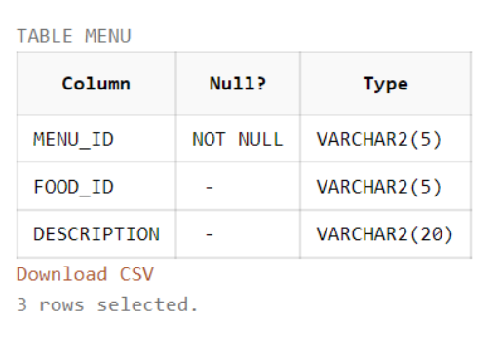
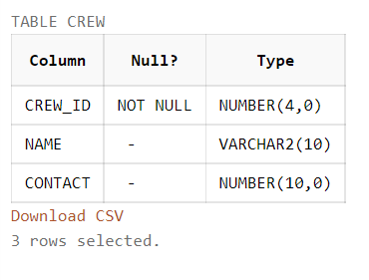
TABLES (MENU, CREW)

Slide 5
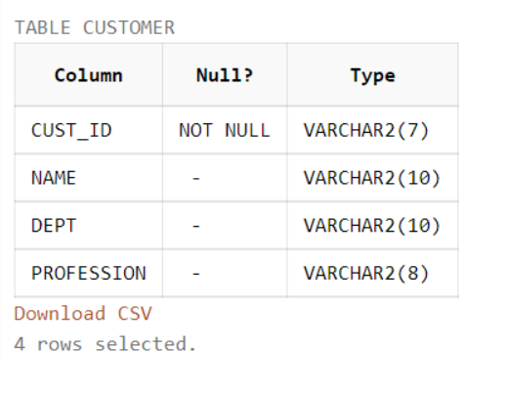
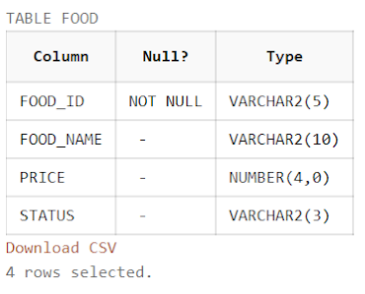
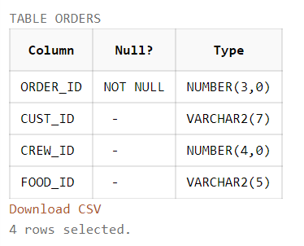
TABLES (CUSTOMER, FOOD, ORDERS)

Slide 6
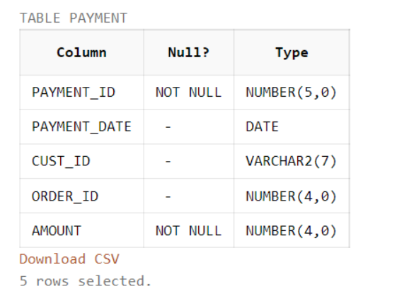
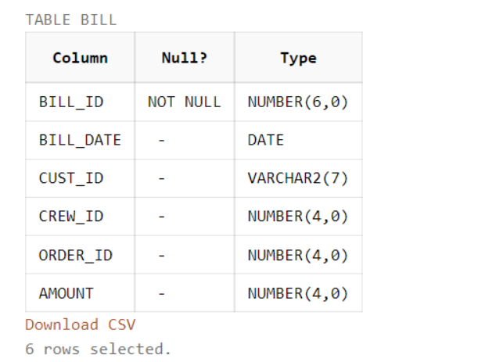
TABLES (PAYMENT, BILL)

Slide 7
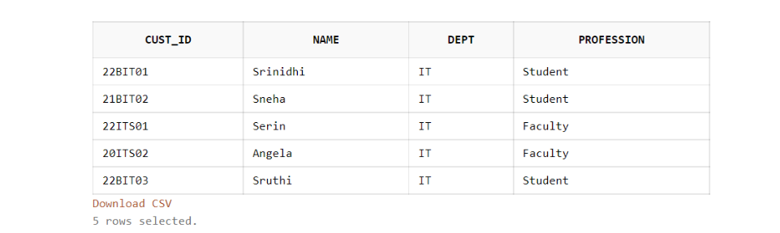
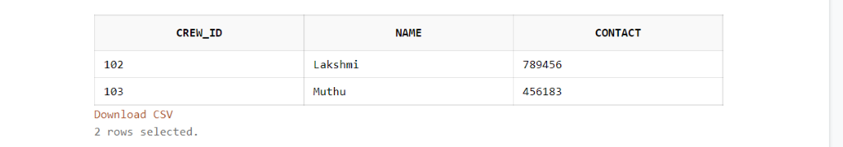
TABLE CONTENTS
Customer Table
Crew Table

Slide 8
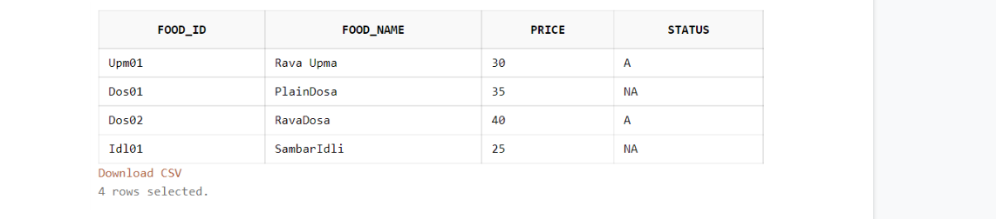
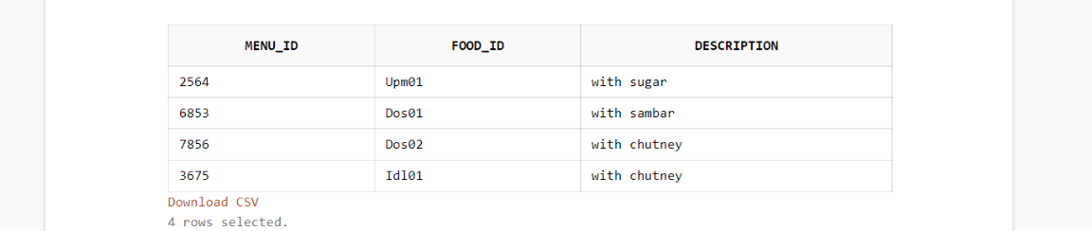
TABLE CONTENTS
Food Table
Menu Table

Slide 9
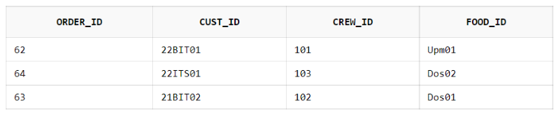
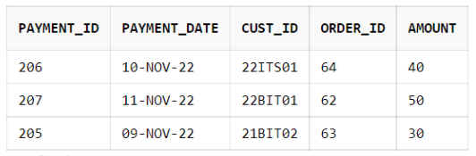
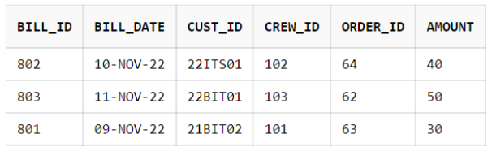
TABLE CONTENTS
Customer Table
Payment Table
Bill Table

Slide 10
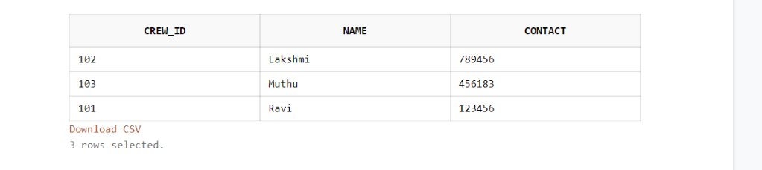
CONSTRAINTS - DEFAULT
The DEFAULT keyword provides a default value to a column when the Oracle INSERT INTO statement does not provide a specific value. Here the Default Value is 101 for the Crew_ID.
Syntax
ALTER TABLE crew
MODIFY crew_id DEFAULT 101 ;

Slide 11
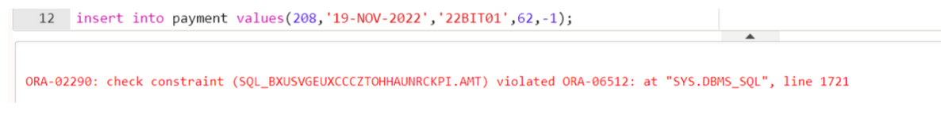
CONSTRAINTS - CHECK
A Check Constraint allows you to enforce domain integrity by limiting the values accepted by one or more columns. Oracle uses this expression to validate the data that is being inserted or updated.
Syntax
ALTER TABLE payment
ADD CONSTRAINT amt CHECK (amount>0);

Slide 12
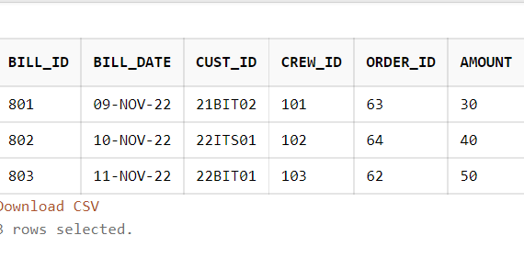
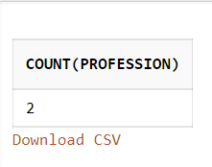
GROUP BY, COUNT, ORDER BY
Syntax
Syntax
SELECT COUNT(Profession)
FROM customer WHERE Profession = 'Faculty'
GROUP BY Profession;
SELECT * FROM bill
ORDER BY bill_date ;

Slide 13
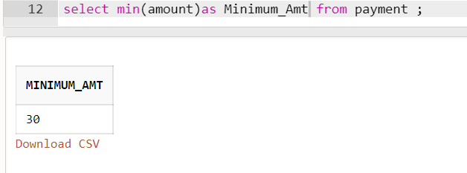
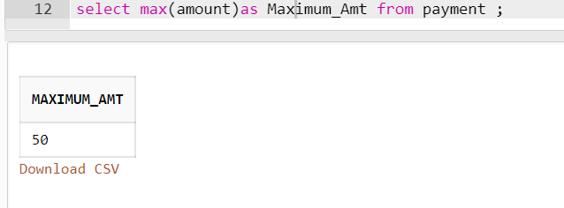
MIN, MAX FUNCTIONS
01 MIN():
02 MAX():
SELECT MIN(amount)
AS Minimum_Amt
FROM payment;
SELECT MAX(amount)
AS Maximum_Amt
FROM payment;

Slide 14
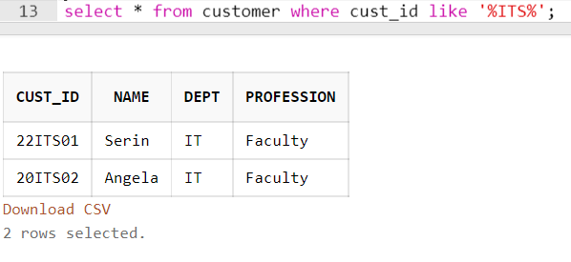
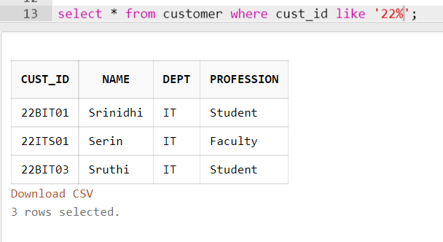
LIKE
OPERATOR
02 LIKE (xx%):
SELECT * FROM customer
WHERE cust_id LIKE '22%' ;
01 LIKE (%xx%):
SELECT * FROM customer
WHERE cust_id LIKE '%ITS%' ;

Slide 15
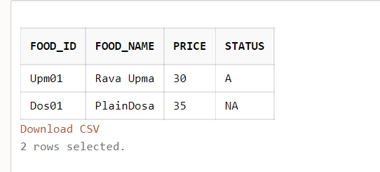
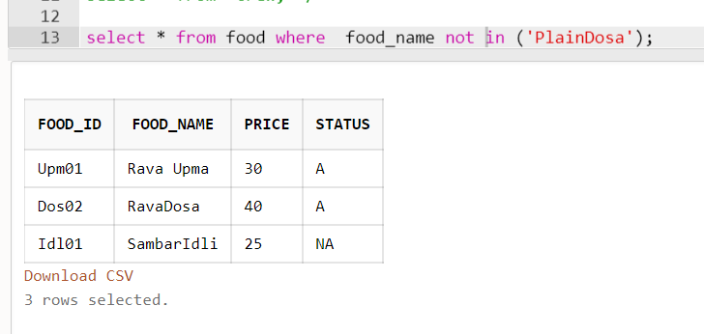
IN, NOT IN OPERATOR
02 NOT IN:
SELECT * FROM food
WHERE food_name NOT IN ('PlainDosa') ;
01 IN:
SELECT * FROM food
WHERE food_name IN ('Rava Upma', 'PlainDosa') ;

Slide 16
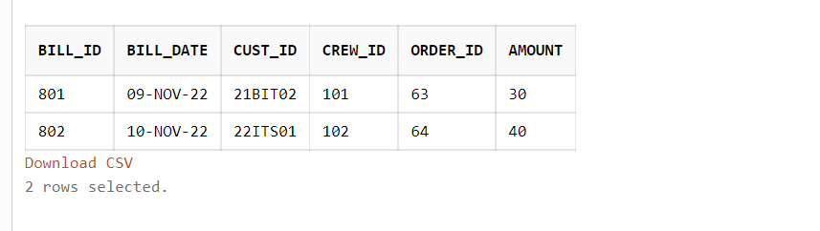
BETWEEN
Syntax
SELECT * FROM bill
WHERE bill_date BETWEEN '09-NOV-2022 AND '10-NOV-2022'
ORDER BY bill_id;

Slide 17
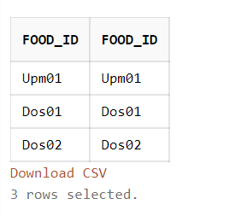
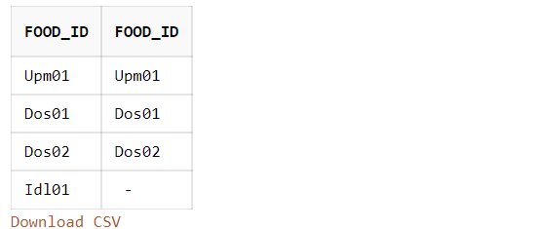
JOINS -
INNER, FULL
01 INNER JOIN:
02 FULL JOIN:
SELECT menu.food_id, orders.food_id
FROM menu INNER JOIN orders
ON menu.food_id=orders.food_id;
SELECT menu.food_id, orders.food_id
FROM menu FULL JOIN orders
ON menu.food_id=orders.food_id;

Slide 18
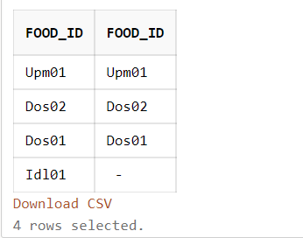
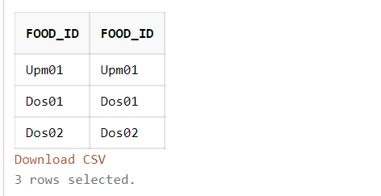
JOINS - LEFT, RIGHT
Syntax
Syntax
SELECT menu.food_id, orders.food_id
FROM menu LEFT JOIN orders
ON menu.food_id=orders.food_id;
SELECT menu.food_id, orders.food_id
FROM menu RIGHT JOIN orders
ON menu.food_id=orders.food_id;

Slide 19
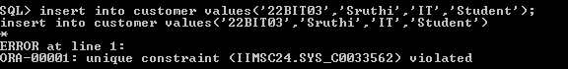
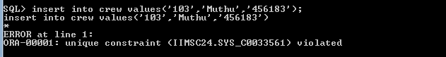
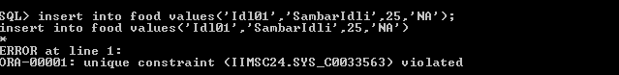
VIOLATIONS
PRIMARY KEY VIOLATIONS
Customer Table:
Crew Table:
Food Table:

Slide 20
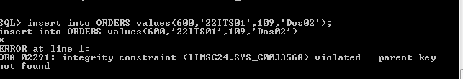
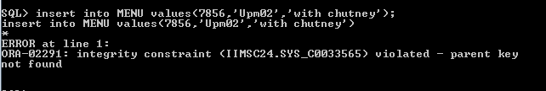
VIOLATIONS
FOREIGN KEY VIOLATIONS
Orders Table:
Menu Table:

Slide 21
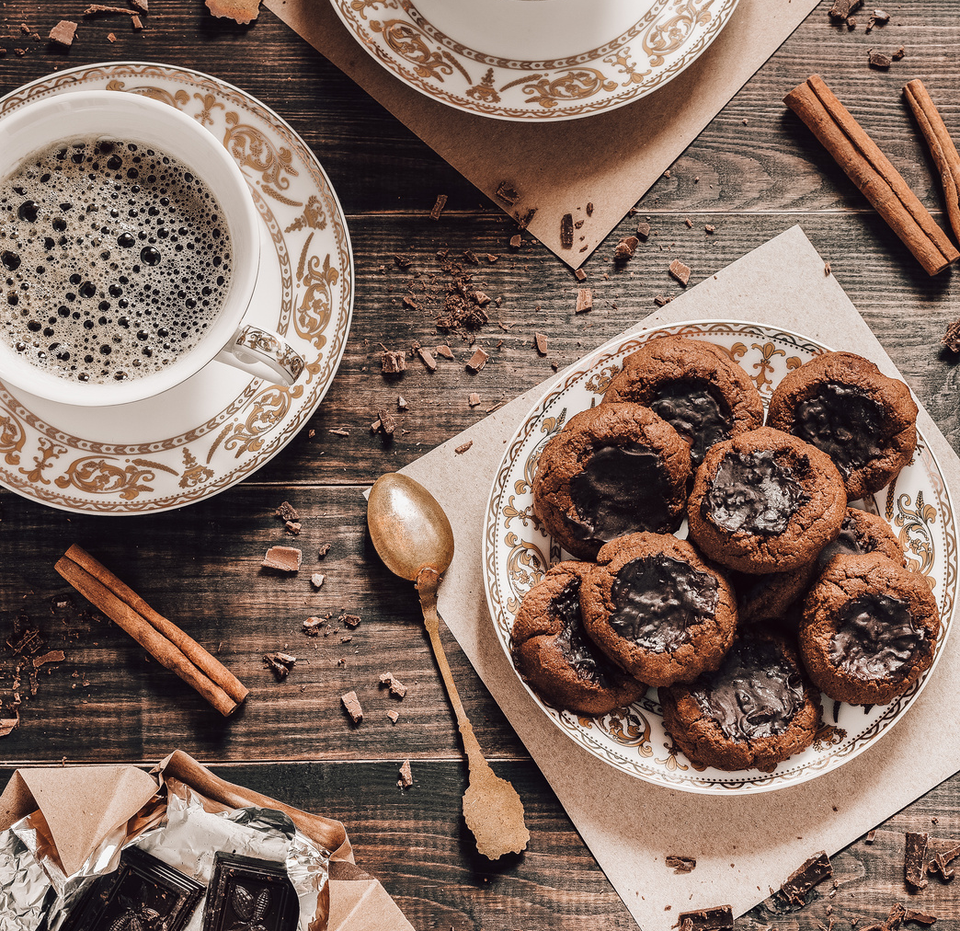
THANKYOU
Sneha S, Srinidhi A
BY

